Slide 1
Front End Web Development
Topic 8:
jQuery
Notes:
NCC Education - Title Master

Slide 2
Scope and Coverage
This topic will cover:
jQuery introduction
jQuery Syntax
jQuery Events
jQuery Effects
DOM
jQuery UI
Notes:
NCC Education - Slide Master

Slide 3
Learning Outcomes
By the end of this topic students will be able to:
Explain jQuery concepts
Create animated, interactive web pages using jQuery library
Make use of simple jQuery examples
Explain jQuery Events and Effects
Describe jQuery UI

Slide 4
Unit Roadmap
Week | Topic | Week | Topic
1 | Overview of Web Application Architecture | 7 | JavaScript - II
2 | Introduction to HTML5 | 8 | jQuery
3 | Introduction to CSS | 9 | Responsive CSS Framework: Bootstrap - I
4 | HTML and CSS | 10 | Responsive CSS Framework: Bootstrap - II
5 | CSS Flexbox and Grid Layout | 11 | Code Review and Testing. and Collaboration
6 | JavaScript - I | 12 | Unit Summary

Slide 5
jQuery

Slide 6

Introduction to jQuery
jQuery is a lightweight, feature rich JavaScript library
jQuery provides easy-to-use APIs to achieve the following:
Manipulate HTML, CSS and DOM
Handling HTML events
Applying effects and animations
AJAX
Utilities
One of the most popularly used OpenSource libraries
Reduces the number of lines of code when compared with JavaScript

Slide 7
Introduction to jQuery
Most popular and extendable library for websites and mobile single page app development
As of June 2022, jQuery is used on 73% of the top 1 million websites, and by 22.4% of overall number of websites
Large companies (ex: Google) use jQuery library and host jQuery CDN (Both Google and Microsoft)
jQuery simplifies the syntax for finding, selecting, and manipulating DOM elements
jQuery is supported by all modern browsers.

Slide 8
jQuery Development Principles
P1: Separation of HTML and JS
Simple syntax for handling DOMs (Ex: Events)
Avoids need for adding HTML event attributes to call JavaScript functions
JavaScript code is separated from HTML
P2: Elimination of cross-browser incompatibilities
JavaScript incompatibility with different browsers is eliminated
Makes JavaScript universal across browsers
jQuery handles all these cross-browser inconsistencies and provides a consistent interface
P3: Extensibility
New events, elements, and methods can be easily added and reused as a plugin

Slide 9
jQuery syntax
jQuery syntax is designed to select HTML elements and perform actions on them.
Syntax: $(selector).action() Selector : this | id | class | element
$(this).action();
$(“div”).action();
$(“.abc”).action();
// Take action on current element
// Take action on all divisions
// Take action on all abc class
Actions can be of varied in nature (ex: DOM manipulation, events etc..) which will be covered in the subsequent slides
The $ used is a jQuery function

Slide 10
jquery events

Slide 11
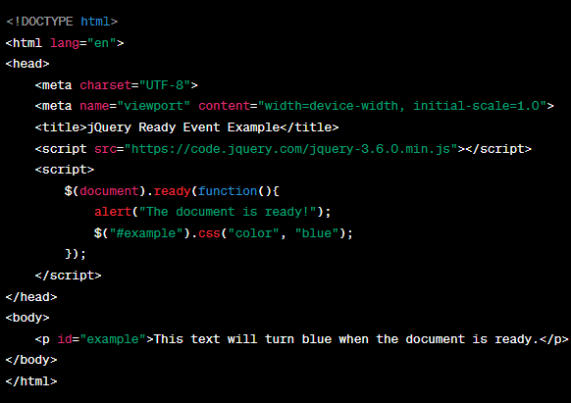
jQuery Ready Event
Ensure the DOM tree is fully created before utilising jQuery to access elements
DOM tree is created using the “ready” event
If it is not created, following failures may happen:
Finding an element that is not created
Hiding an element that is not created
jQuery detects the state of readiness of document then perform actions

Slide 12
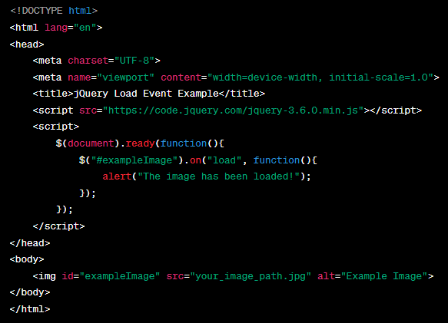
jQuery Load Event
Load event is used to detect when a specific element has completely loaded.
Useful for executing a function when an image, script, or iframe has been loaded.

Slide 13
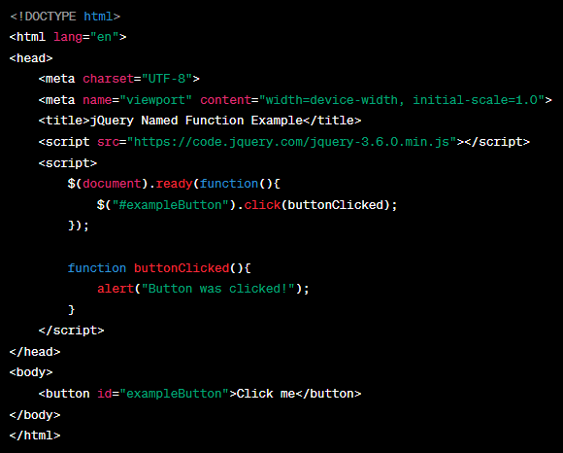
jQuery Passing Named Functions
Define named functions and then use them as handlers for events

Slide 14
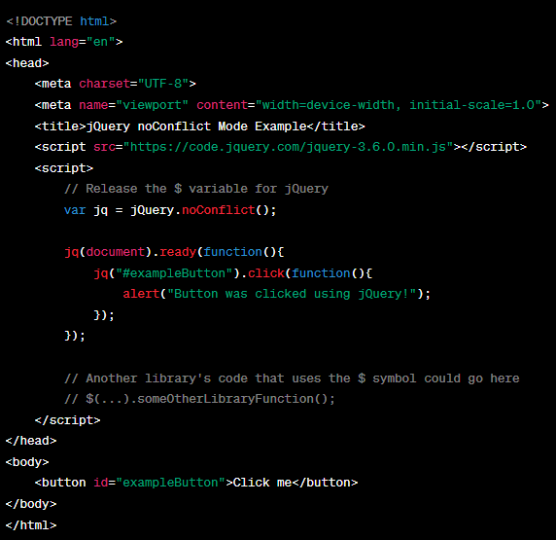
jQuery noConflict Mode
By default, jQuery uses $ as a shortcut for jQuery
If another JavaScript library uses the $ variable, creates conflicts with jQuery
To avoid these conflicts, put jQuery in no-conflict mode immediately after it is loaded onto the page and before attempt to use jQuery in the page

Slide 15
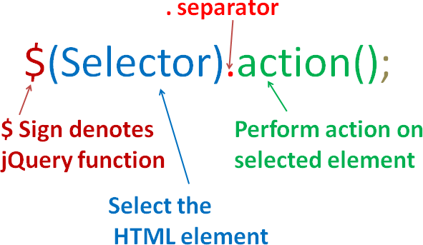
Selectors
Selectors are the most basic concept of jQuery
As the name of jQuery implies - select some elements and do something with them
jQuery supports most CSS3 selectors, as well as some non-standard selectors
Combination of selectors provides an easy way to modify / manipulate HTML elements
All selectors in jQuery start with the dollar sign and parentheses $() followed by action

Slide 16
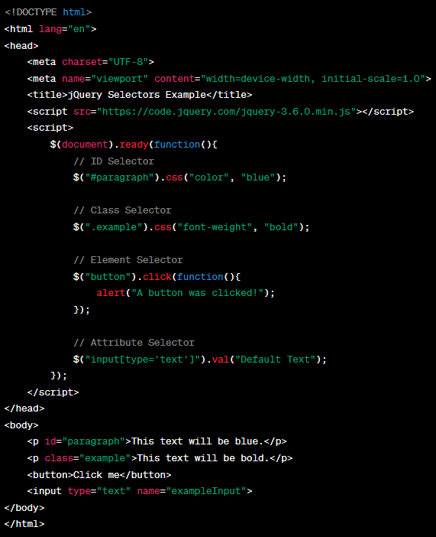
Selectors - Example

Slide 17
Element Selectors
Selector
Description
$("*")
Selects all elements
$("#id")
Selects an element having identifier as id
$(".class-name")
Selects element with class as class-name
$("p:first")
Selects first element in a paragraph
$("ul li:first")
Selects the first <li> element of the first <ul>
$("[href]")
Selects all elements with an href attribute
$(":button")
Selects all <button> elements and <input> elements of type="button"
$("tr:even")
Selects all even <tr> elements
$("tr:odd")
Selects all odd <tr> elements
$("div:gt(2)")
All div elements except the first three

Slide 18
Quiz -1
1. How do you select all elements with the class 'example' using jQuery?
A) $("example")
B) $(".example")
C) $("#example")
2. Which jQuery selector is used to select an element with the ID 'unique'?
A) $(".unique")
B) $("unique")
C) $("#unique")
3. How do you select all <p> elements inside a <div>?
A) $("div p")
B) $("div + p")
C) $("div > p")
Notes:
Correct Answer: B) $(".example")
Correct Answer: C) $("#unique")
Correct Answer: A) $("div p")

Slide 19
jquery events and effects

Slide 20
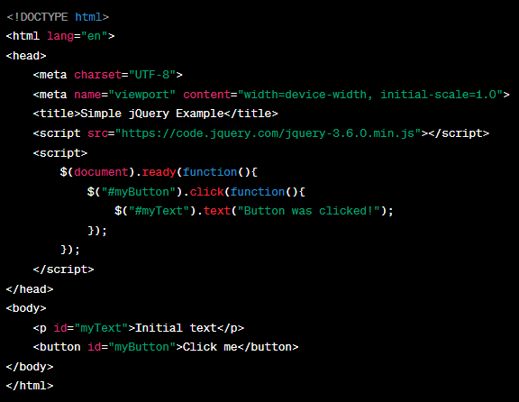
Event Handling Using jQuery
Events bring interactivity with users
Many peripherals (ex: mouse) can be the source of events
Upon events appropriate is done called as Event Handling
In JavaScript event handling was done by implementing methods in HTML element itself
jQuery provides better facility to handle them by de-coupling from HTML
Selectors are combined with actions on a particular event

Slide 21
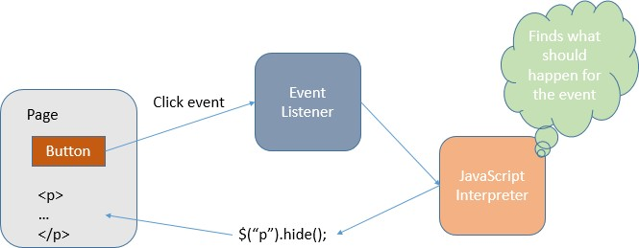
Example Events
Selector | Description
Mouse | click | dbclick | hover | mouseenter | mouseleave
Keyboard | keypress | keyup | keydown
Form | focus | blur | submit
Window (BOM) | load | resize

Slide 22
Introduction to Effects
Effects provide more options to operate on an HTML element
jQuery offers multiple options, e.g. showing / hiding
It enables animation-oriented application
Effects provide easier way to deal with HTML elements
Fewer lines of code is needed
Multiple effects can be combined as well using jQuery effects chaining

Slide 23
Hide and Show Effects
Selector | Description
$(selector).hide(speed,callback); | Hide the selected element Speed - slow | fast | milliseconds Callback - will study in later topic
$(selector).show(speed,callback); | Show the selected element
$(selector).toggle(speed,callback); | Toggle between hide and show of the selected element

Slide 24
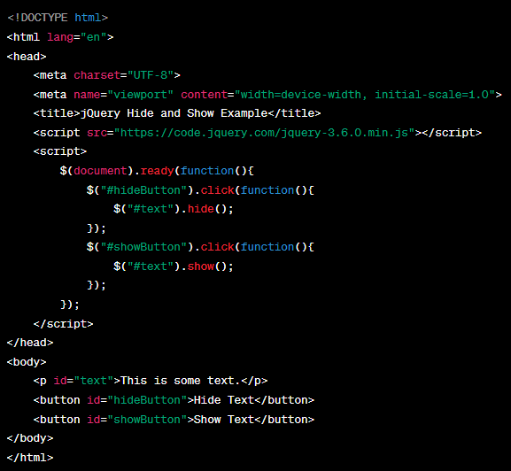
Hide and Show Effects Example

Slide 25
Fading Effects
Selector | Description
$(selector).fadeIn(speed,callback); | It is used to fade in a hidden elements
$(selector).fadeOut(speed,callback); | It is used to fade out a visible element
$(selector).fadeToggle(speed,callback); | Toggles between the fadeIn() and fadeOut() methods
$(selector).fadeTo(speed,opacity,callback); | Allows fading to a given opacity (value between 0 and 1)

Slide 26
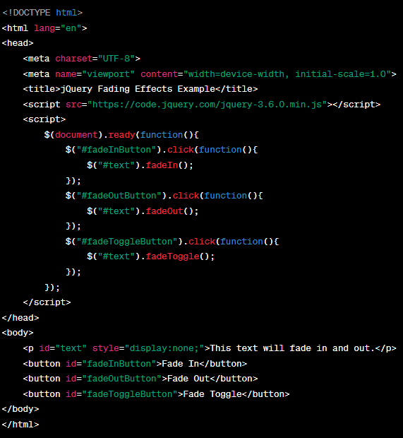
Fading Effects - Example

Slide 27
Sliding Effects
Selector | Description
$(selector).slideDown(speed,callback); | Slide down an element
$(selector).slideUp(speed,callback); | Slide up an element
$(selector).slideToggle(speed,callback); | Toggles between the slideDown() and slideUp() methods

Slide 28
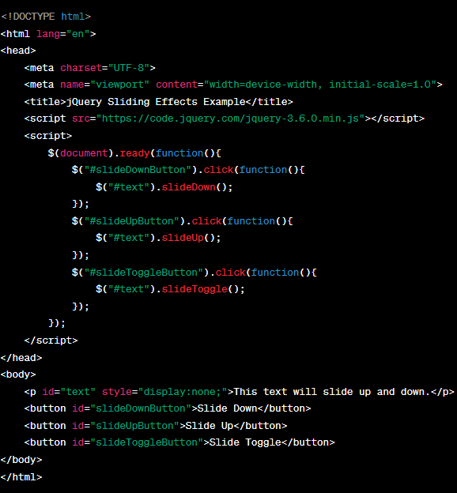
Sliding Effects

Slide 29
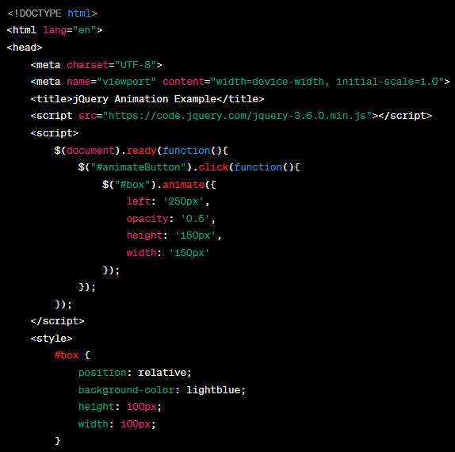
Animation Effects
Selector & Description
$(selector).animate({params},speed,callback);

Slide 30
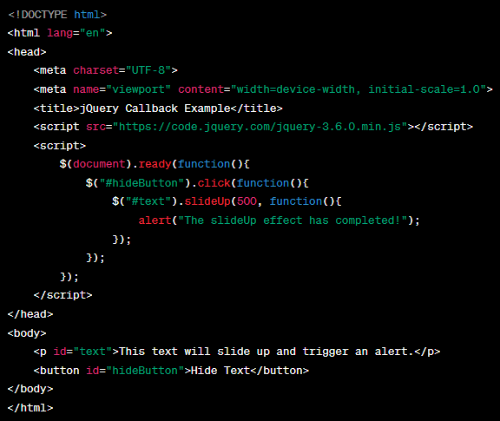
Callback usage in jQuery
JavaScript is an interpreted language, where statements are executed line by line
In case of effects, the next line of code can be run even though the current effect is not finished
This will create issue in getting the correct output
In order to prevent this call-back functions are provided in jQuery
Callback function is executed after the current effect is finished

Slide 31
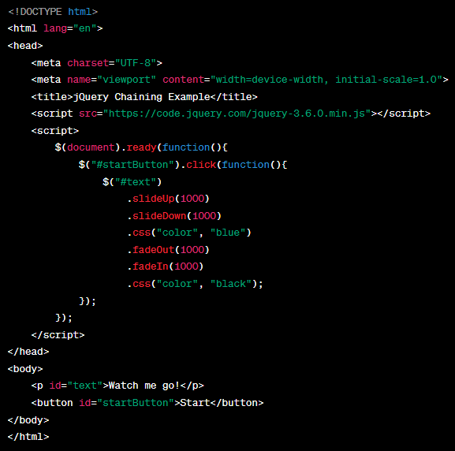
Chaining in jQuery
Multiple jQuery actions/methods can be combined together
It helps to execute multiple actions using single statement

Slide 32
Quiz - 2
1. Which method is used to hide an element with a sliding motion in jQuery?
A) slideHide()
B) slideUp()
C) hideSlide()
2. How do you apply a fading out effect to an element with jQuery?
A) fadeOut()
B) fadeAway()
C) opacityOut()
3. Which jQuery method is used to animate the custom properties of an element?
A) animate()
B) customAnimate()
C) motion()
Notes:
Correct Answer: B) slideUp()
Correct Answer: A) fadeOut()
Correct Answer: A) animate()

Slide 33
jquery dom

Slide 34
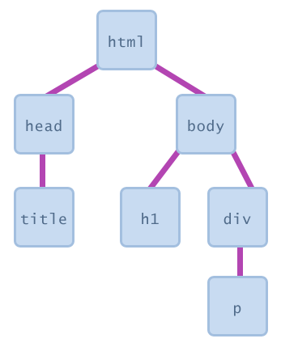
Document Object Model (DOM)
Document Object Model (DOM) is a platform and language-neutral interface that allows programs and scripts to dynamically access and update the content, structure, and style of a document.
jQuery provides multiple methods to manipulate DOM.
Using these methods it is easy to access and manipulate elements and attributes.
It also provides methods to change browser window dimensions.

Slide 35
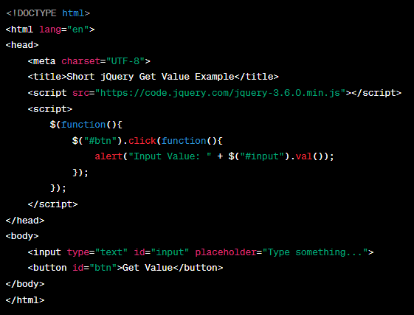
DOM APIs
Selector | Description
$(selector).text(); | Sets or returns the text content of selected elements
$(selector).html(); | Sets or returns the content of selected elements (including HTML mark-up)
$(selector).val(); | Sets or returns the value of form fields

Slide 36
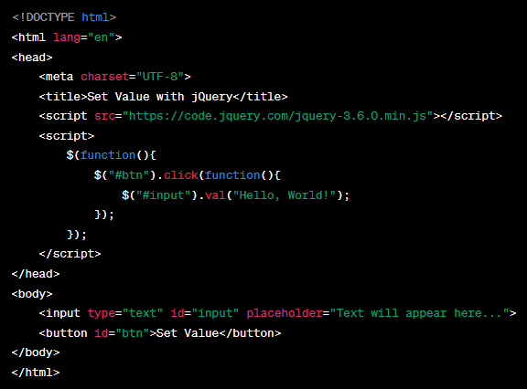
Setting values using DOM APIs

Slide 37
DOM APIs – Insert and Remove
Selector | Description
$(selector).append(); | Inserts content at the end of the selected elements
$(selector).prepend(); | Inserts content at the beginning of the selected elements
$(selector).after(); | Inserts content after the selected elements
$(selector).before() | Inserts content before the selected elements
$(selector).remove(); | Removes the selected element (and its child elements)
$(selector).empty(); | Removes the child elements from the selected element

Slide 38
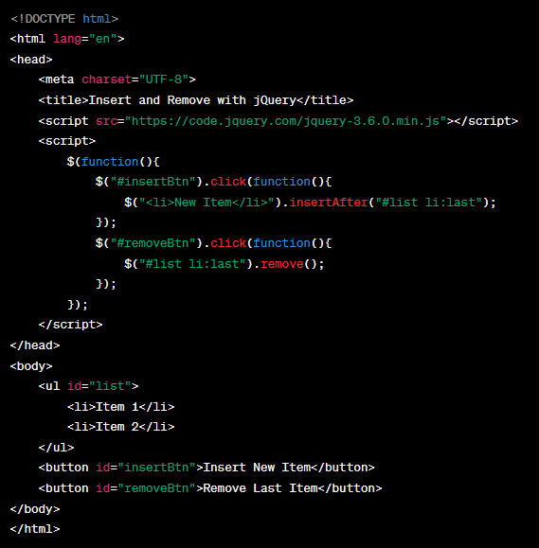
DOM APIs – Insert and Remove Example

Slide 39
jQuery – Dimension APIs
Selector | Description
$(selector).width(); | Sets or returns the width of an element (excludes padding, border and margin)
$(selector).height(); | Sets or returns the height of an element (excludes padding, border and margin).
$(selector).innerWidth(); | Returns the width of an element (includes padding)
$(selector).innerHeight(); | Returns the height of an element (includes padding)
$(selector).outerWidth(); | Returns the width of an element (includes padding and border)
$(selector).outerHeight(); | Returns the height of an element (includes padding and border)

Slide 40
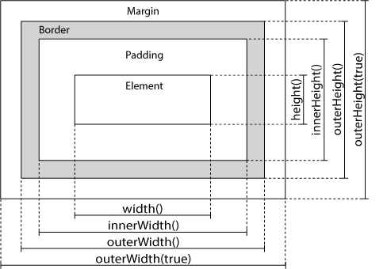
jQuery – Dimension APIs

Slide 41
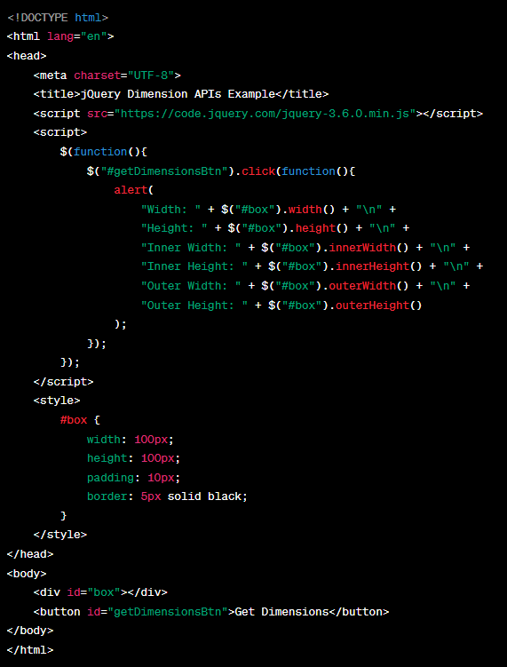
Example – Dimensions API

Slide 42
jquery ui

Slide 43
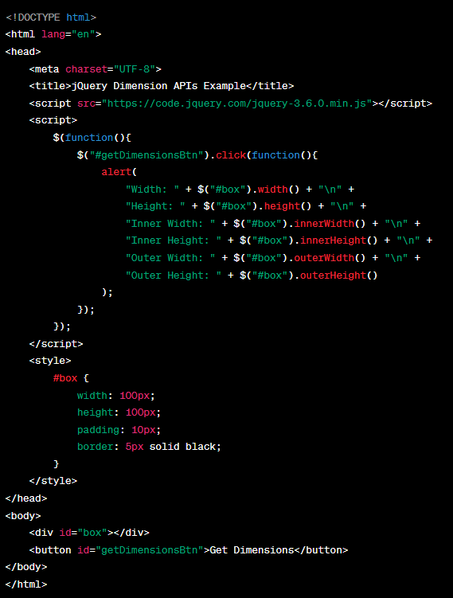
jQuery UI – draggable()
The jQuery UI draggable() method makes any DOM element draggable after which you can drag it anywhere within the HTML page.
Syntax: $(selector).draggable();

Slide 44
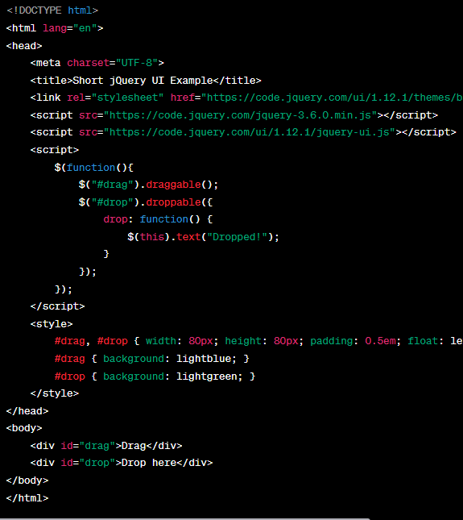
jQuery UI – droppable()
The jQuery UI droppable() method makes any DOM element droppable that can be dropped at a specified target area on the HTML page.
Syntax: $(selector).droppable();

Slide 45
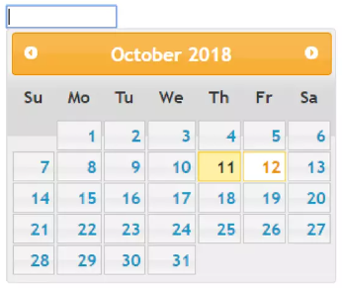
jQuery UI – DatePicker
The jQuery UI datepicker facilitates user to enter dates easily and visually with an aid of calendar widget
More options in the jQuery UI Datepicker API documentation
Syntax:
$(selector).datepicker();

Slide 46
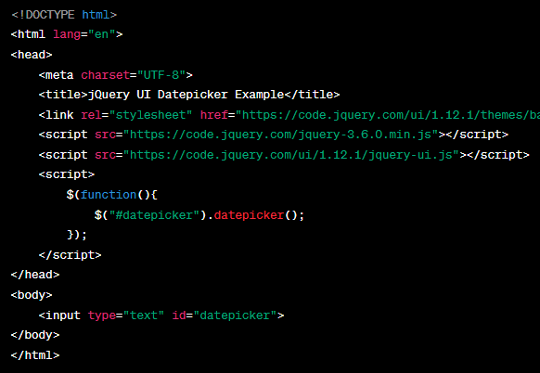
jQuery UI – DatePicker Example

Slide 47
References
Books:
jQuery Introduction & Syntax
Chaffer, J., & Swedberg, K. (2013). jQuery in Action. Manning Publications.
jQuery Events & Effects
Bibeault, B., & Katz, Y. (2015). Learning jQuery, 3rd Edition. Packt Publishing.
DOM
Duckett, J. (2014). JavaScript and JQuery: Interactive Front-End Web Development. John Wiley & Sons.
jQuery UI
Libby, A. (2014). jQuery UI in Action. Manning Publications. Web Resources
jQuery Introduction
jQuery.com. jQuery Introduction. Available at: jQuery Introduction
jQuery Syntax
W3Schools. jQuery Syntax. Available at: W3Schools jQuery Syntax
jQuery Events
Mozilla Developer Network (MDN). Introduction to events. Available at: MDN Events
jQuery Effects
jQuery.com. jQuery Effects. Available at: jQuery Effects
DOM
Mozilla Developer Network (MDN). Introduction to the DOM. Available at: MDN DOM Introduction
jQuery UI
jQueryUI.com. jQuery UI. Available at: jQuery UI

Slide 48
Topic 8 – jQuery
Any Questions?
Notes:
NCC Education - End Slide Master

